Slide 1
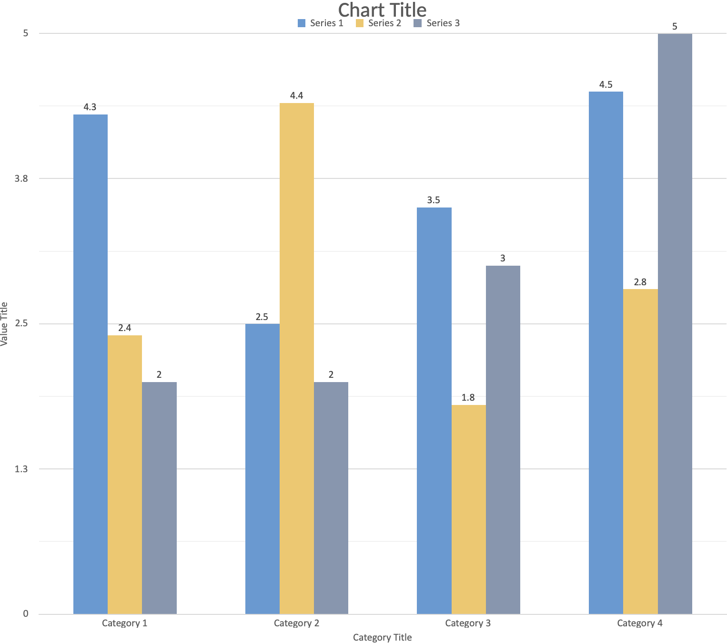
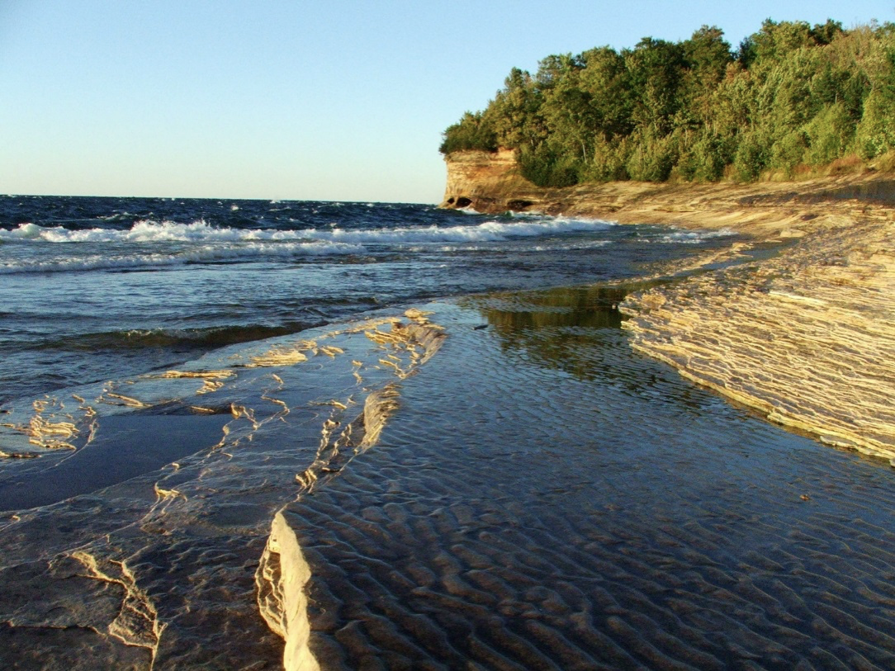
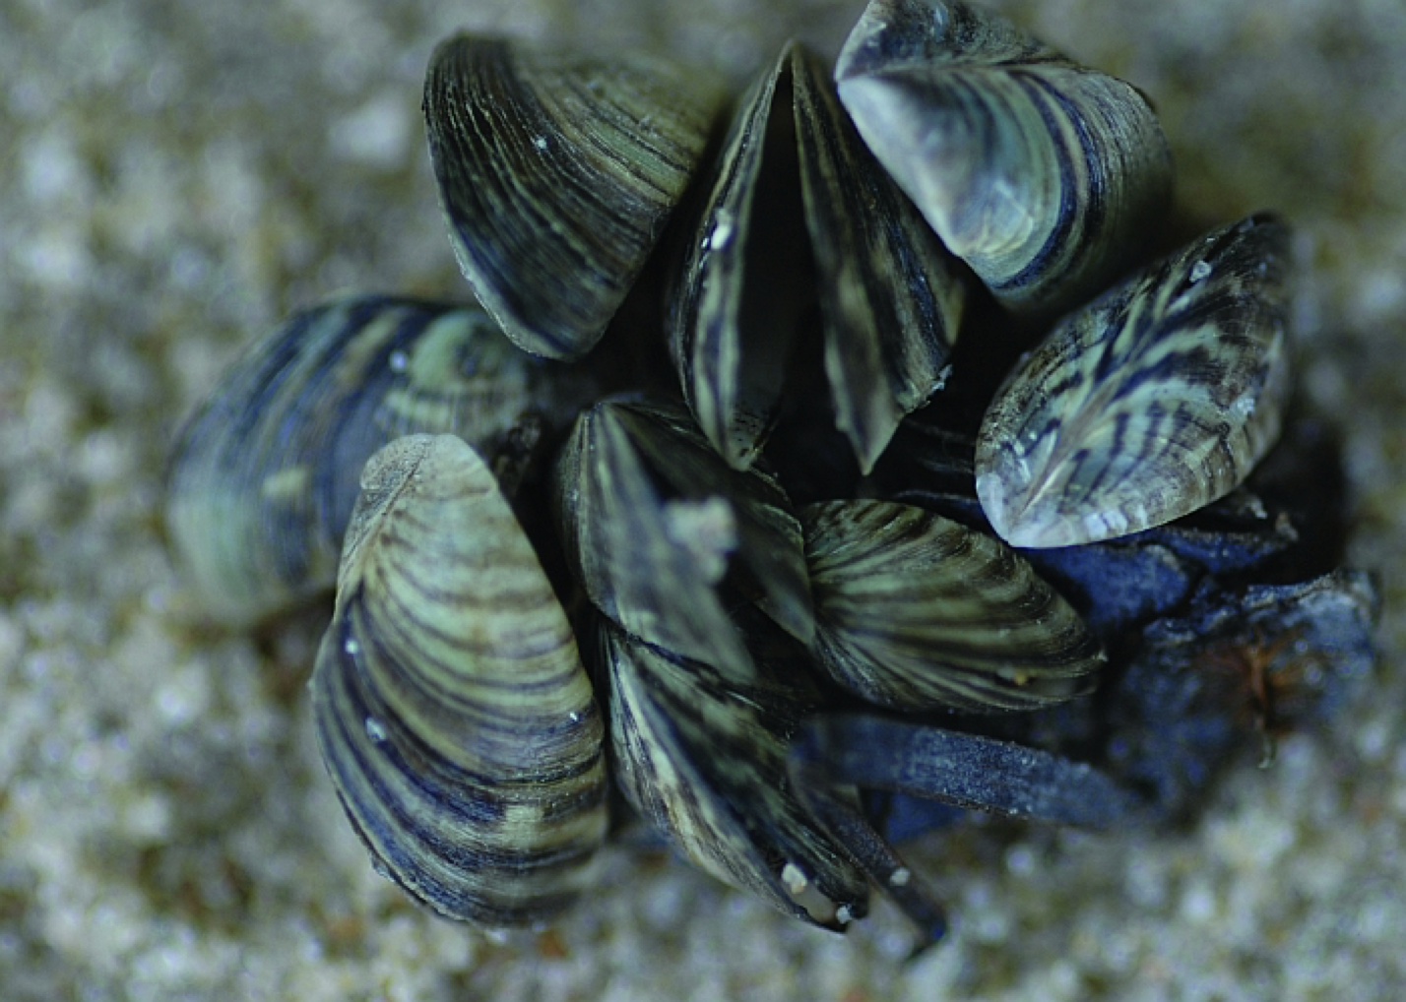
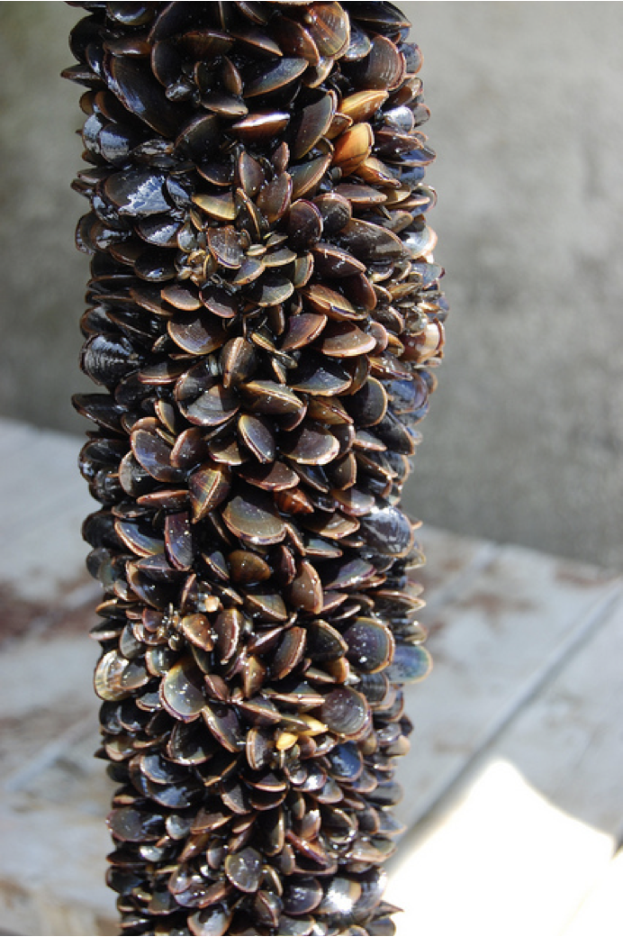
What is the purpose of your poster? Scientific posters follow this general outline:
Abstract
Introduction
Materials and Methods
Results
Discussion
References
Acknowledgements
Title of Your Research Project
PLACE ANY SUBTITLES OR ADDITIONAL INFORMATION HERE
Research Members
Department Name, Institution
INTRODUCTION
Text should be sized so are larger than supplementary information. Make sure the font sizes and styles you use are readable from six feet away from the poster.
This poster should serve merely as a prompt, not as a final presented product. It is a summary meant to encourage discussion, so brevity is key! You may want to prepare handouts for more in-depth information.
Posters are summaries, meant to encourage discussion
Use handouts for large amounts of text material
LINES AND SPACING
Avoid centering all your information. This can decrease readability and create a visually unappealing poster. Also keep in mind the overall picture and the way your want your viewers’ eyes to move across the poster.
PLANNING YOUR POSTER
HELPFUL INFORMATION
What is the purpose of your poster? Scientific posters follow this general outline:
Abstract
Introduction
Materials and Methods
Results
Discussion
References
Acknowledgements
BASIC POSTER DESIGN GUIDELINES
Sketch out your design on paper.
Use sans serif fonts for titles. Arial or Helvetica work well. Use serif fonts for body copy. Times New Roman, Palatino, or Garamond work well.
Suggested font sizes:
Title: 72-150 points
Subheads: -60 points
Body Text: -24 points
Use color to unify your poster. Keep contrast high between foreground elements and background. Do not overuse color.
Determine a logical sequence to your material.
Edit carefully. Make sure every word and design element adds to your communication
Proof everything carefully
USE OF IMAGES
Remember: while images and visuals are eye-catching and can make your poster look polished, don’t overuse images. Too many images can make a poster appear crowded and daunting to read.
Be wary of copyright infringements. Images pulled from the internet are often copyrighted, so ensure that you search for images in the creative commons and use your own photos and images when possible. Visit http://www.uwec.edu/copyright/index.htm to learn more about copyright policies and laws.
Place your image subtext here
Place your image subtext here
SHOW WHAT YOU DID
HOW TO NAME YOUR FILE
You can illustrate your process and findings using visuals, such as illustrations, tables, graphs, charts, diagrams, or photos. Make sure to give any image subtext.
The file name you choose MUST begin with your UW-Eau Claire username.
Format: username.ppt
include the four-letter .pptx file extension
Example: leiszgj.pptx
BALANCE THE ELEMENTS
FONT AND COLORING
Limit your font choices to one or two typefaces. Add emphasis using bolded typeface, italics, and color.
The range of your color choices, too, should be limited and consistent so as not to be distracting or make your text difficult to read. Let color communicate meaning (e.g. titles). Keep backgrounds clean and light so dark text can be read. Here, we have utilized gold to signify headings and blue to signify subheadings. The infographics and bullet points mirror these colors to create a cohesive aesthetic that helps unite the information.
HOW TO PRINT YOUR POSTER
Place your image subtext here
To submit and manage your poster requests, visit http://poster.apps.uwec.edu.
Place your image subtext here

